Slide 1
Gene Sequence Analysis
Lecture 4: Phylogenetic Trees
02/06/2024
Phuc Loi Luu, PhD
Apdated from Dr. Morgan Langille

Slide 2
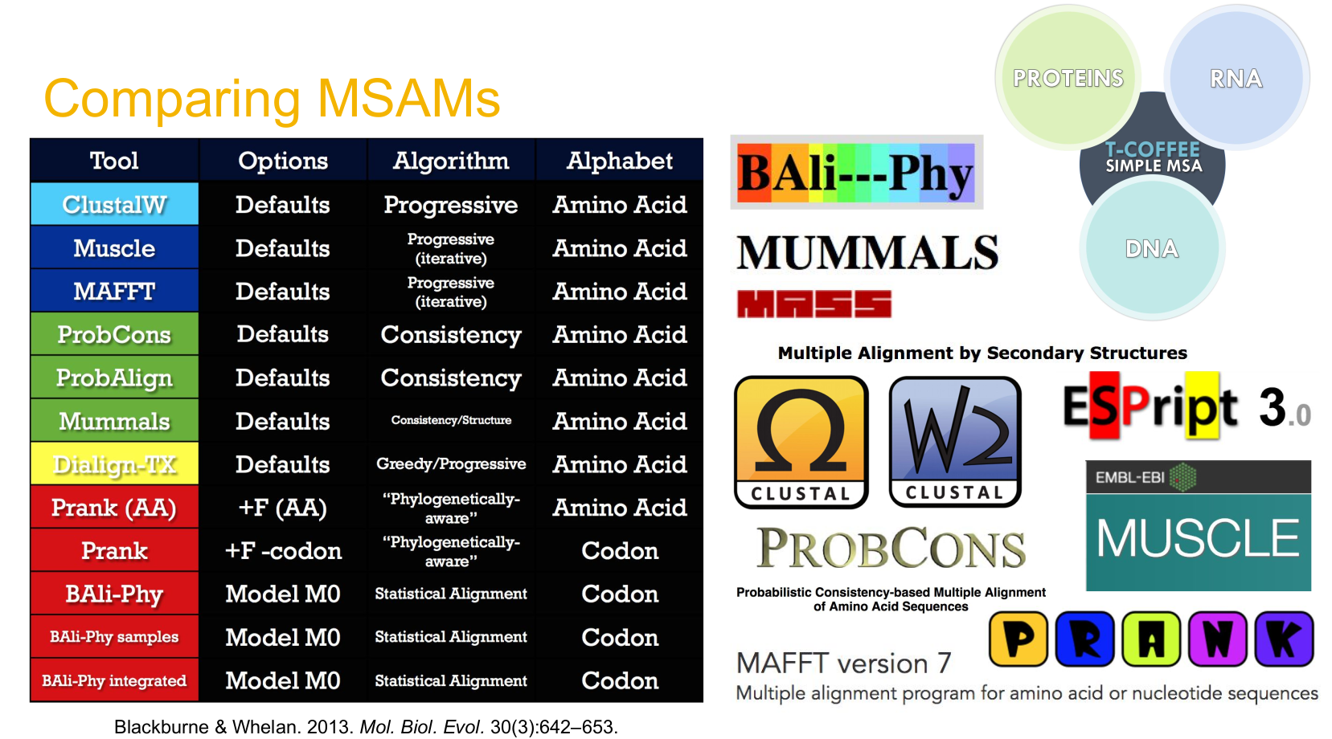
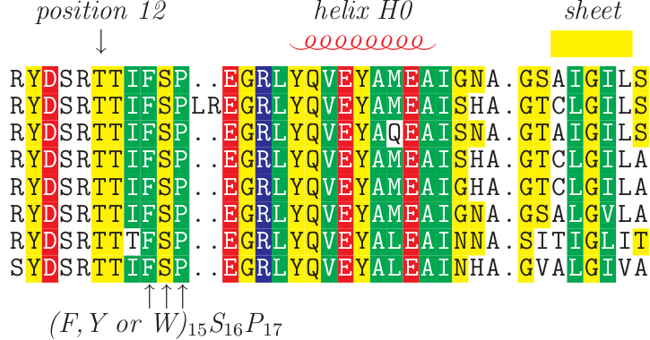

Slide 3
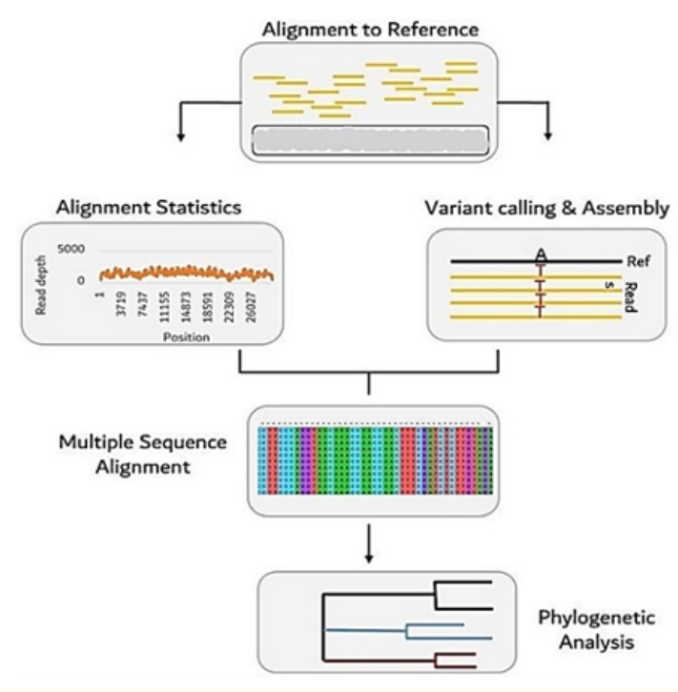
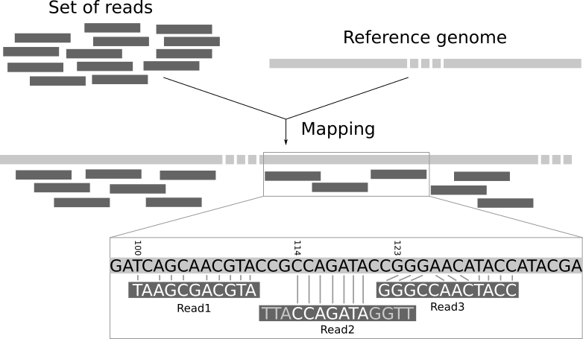

Slide 4
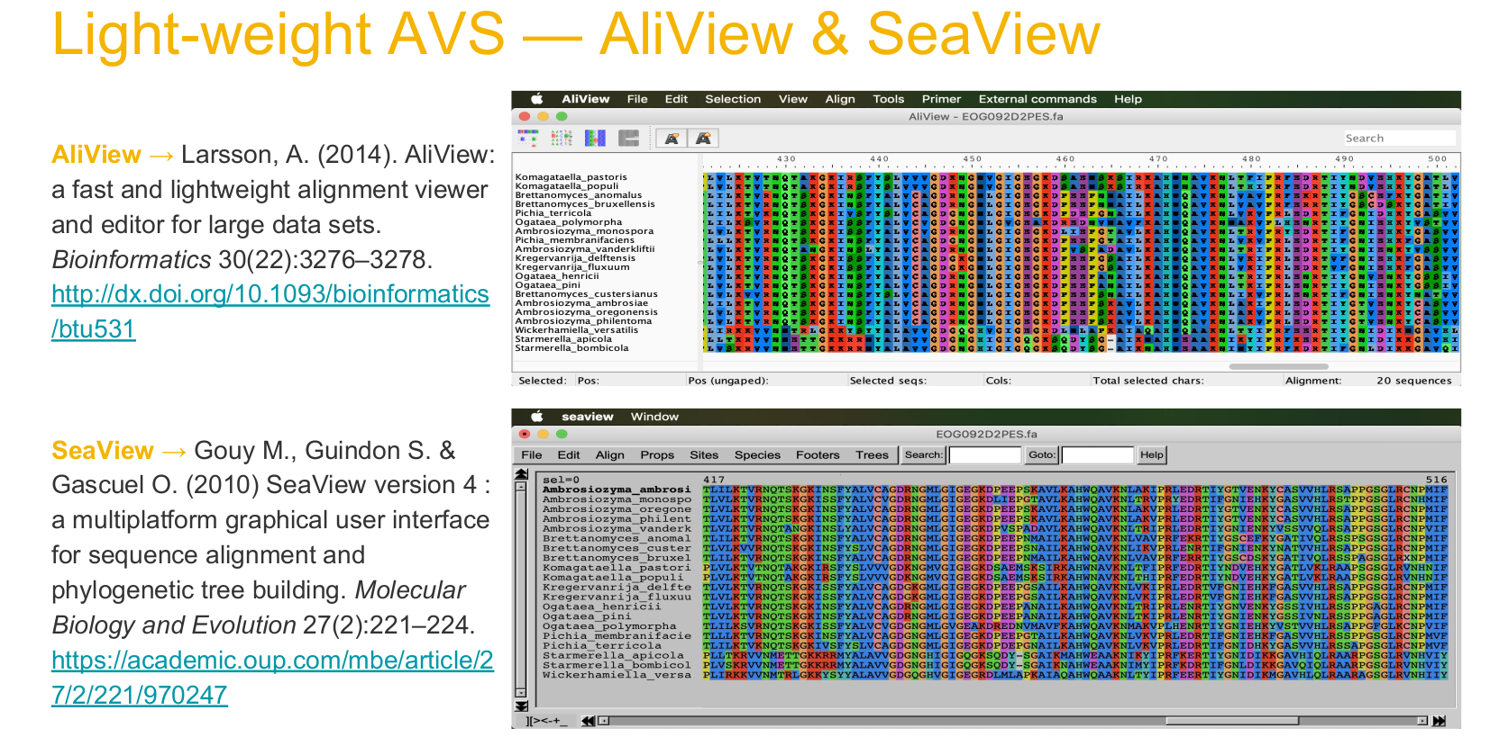

Slide 5
Outline
Why we build trees?
What is a tree?
Parsimony
Neighbour Joining (distance based)
Maximum Likelihood & Bayesian Bootstrapping
Softwares
Tree file formats
●
●
●
●
●
●
●
●

Slide 6
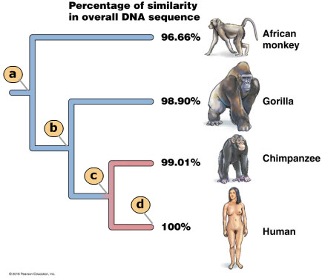
Why do we build trees?
Show relationship of related organisms
Gene trees often used to infer species trees
Gene family history
●
●
●
Duplication
Lateral Gene Transfer
●
●
Determining ancestral states of certain traits Testing or removing phylogenetic signal
●
●

Slide 7
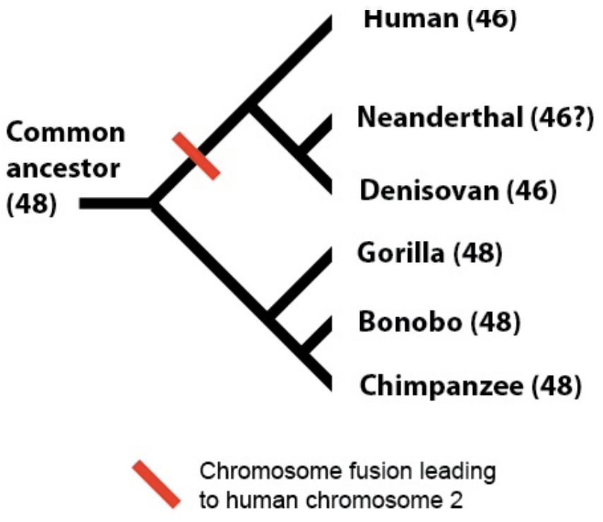
A phylogenetic tree
A node
Human
Sisters
Mouse
Fly
A clade

Slide 8
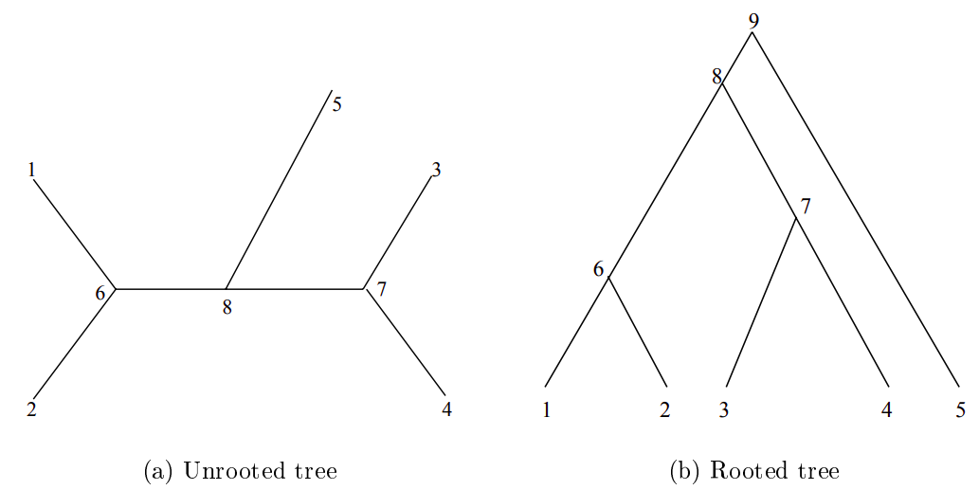
A phylogenetic tree

Slide 9
A phylogenetic tree with branch lengths
A node
Human
D
A clade
B
Mouse
The length of
C
this line means nothing!
Fly
A
Branch length can be significant…
In this case the analysis suggests that the mouse sequence/taxon is slightly more similar to fly than human is to fly
(i.e. sum of branches A+B+C is less than sum of A+B+D)

Slide 10
Parsimony
The tree implying the least number of changes in character states (most parsimonious) is the best.
Note: Does not determine branch lengths

Slide 11
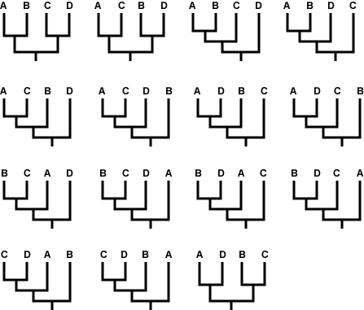
There are 15 different ways that those taxa could be related with Four taxa: A, B, C, and D
https://evolution.berkeley.edu/evolibrary/article/0_0_0/evotrees_build_07

Slide 12
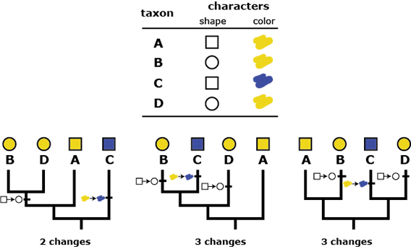
There are 15 different ways that those taxa could be related with Four taxa: A, B, C, and D
https://evolution.berkeley.edu/evolibrary/article/0_0_0/evotrees_build_07

Slide 13
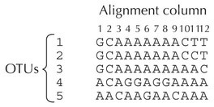
Example Alignment

Slide 14
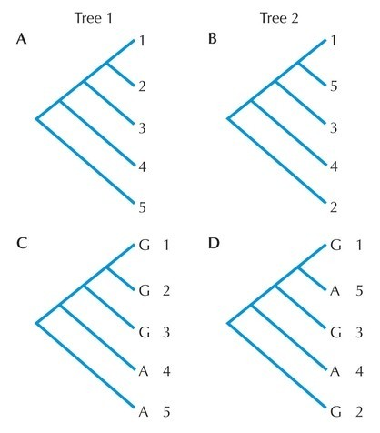
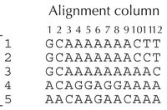
Parsimony Example

Slide 15
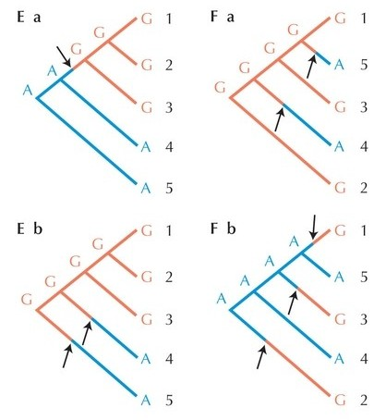
Parsimony Example

Slide 16
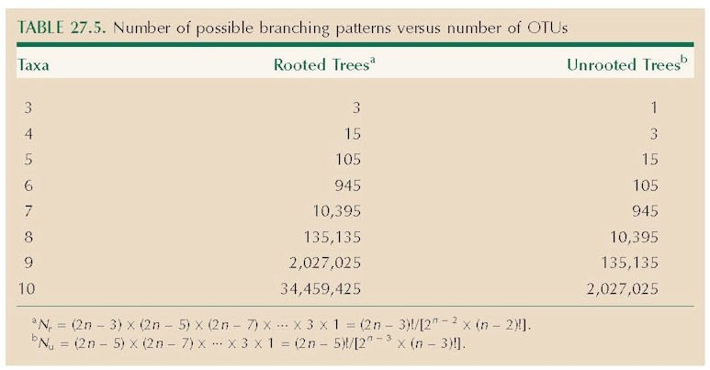
Number of Trees
Scoring every single tree not possible! “Tree Searching” algorithms used.

Slide 17
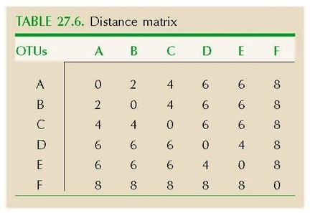
Distance Based Method
●
Start with a distance matrix between every pair of sequences

Slide 18
Distance Based Methods
Unweighted Pair Group method with Arithmetic Mean (UPGMA)
Neighbour Joining
●
●
Advantage:
Computationally Very Fast
Often included in MSA programs
●
●

Slide 19
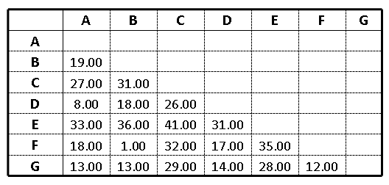
Building an UPGMA Tree - An example
http://www.slimsuite.unsw.edu.au/teaching/upgma/

Slide 20
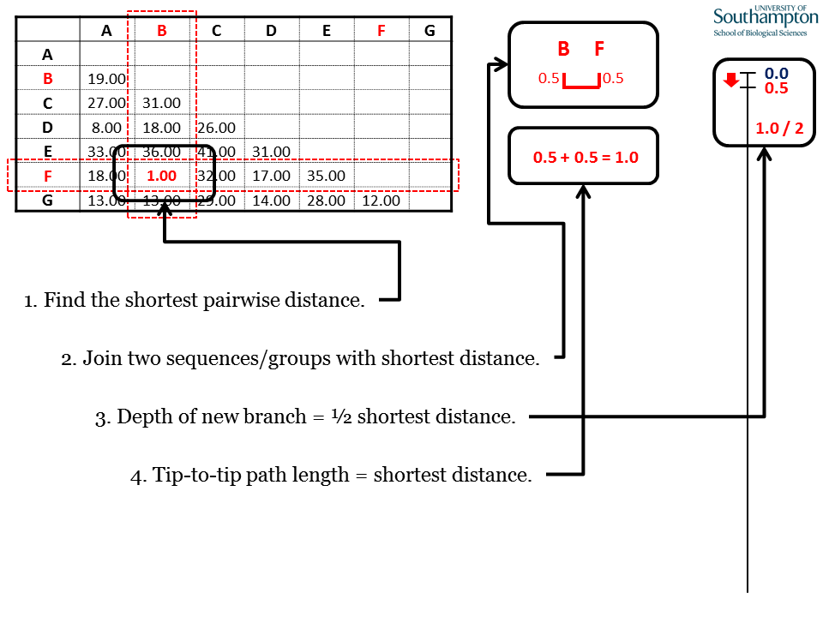
Building an UPGMA Tree - An example
http://www.slimsuite.unsw.edu.au/teaching/upgma/

Slide 21
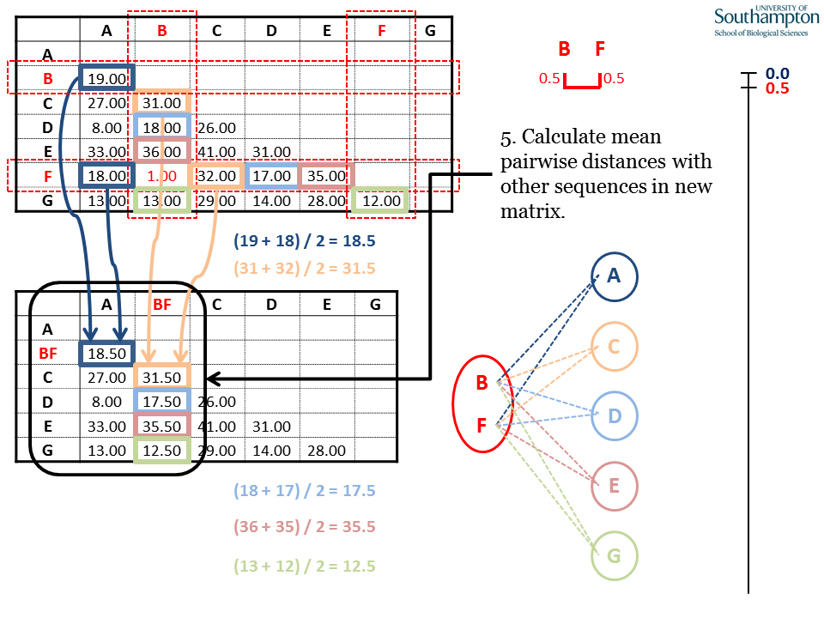
Building an UPGMA Tree - An example
http://www.slimsuite.unsw.edu.au/teaching/upgma/

Slide 22
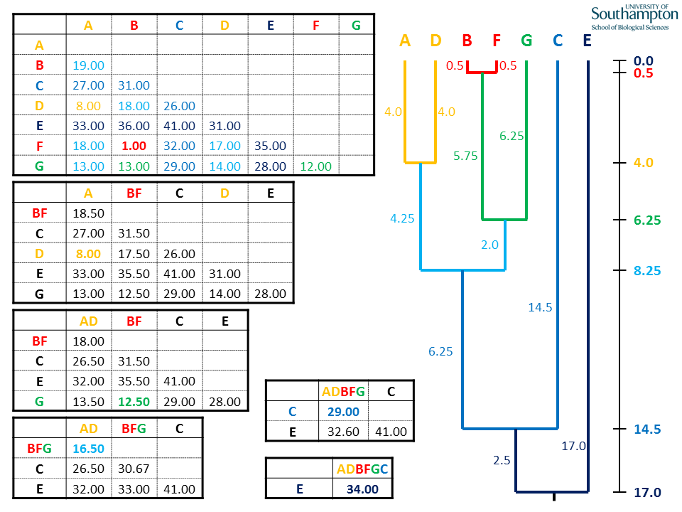
Building an UPGMA Tree - An example
http://www.slimsuite.unsw.edu.au/teaching/upgma/

Slide 23
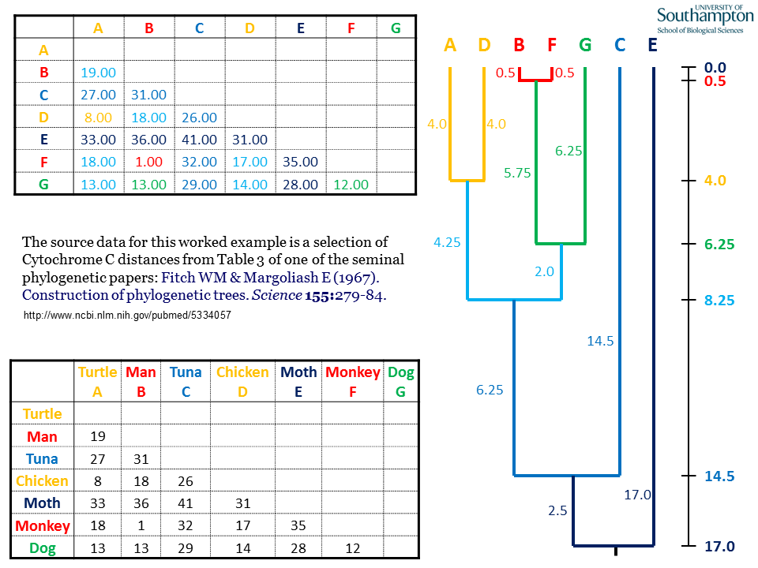
Building an UPGMA Tree - An example
http://www.slimsuite.unsw.edu.au/teaching/upgma/

Slide 24



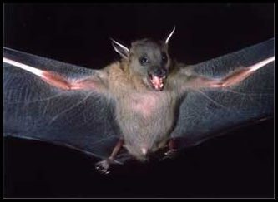

Building an NJ Tree - An Example
Cbw protein from cat, rat, bat, mat and Matt
Compare all sequences to each other
Assign divergence values to each pair
Assemble the values in a distance matrix
Cat | Cat - | Rat | Bat | Mat
Rat | 0.7 | -
Bat | 0.8 | 0.2 | -
Mat | 1.0 | 0.8 | 0.8 | -
Matt | 0.6 | 0.4 | 0.5 | 0.9

Slide 25
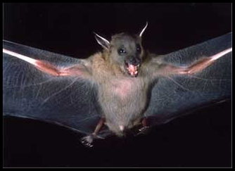




Building a NJ Tree
4. Arrange the subjects in a “star” phylogeny

Slide 26
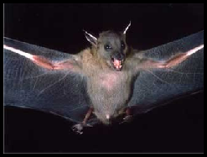




Building a NJ Tree
5. Fuse the two branches with the least divergence
Cat | Cat - | Rat | Bat | Mat
Rat | 0.7 | -
Bat | 0.8 | 0.2 | -
Mat | 1.0 | 0.8 | 0.8 | -
Matt | 0.6 | 0.4 | 0.5 | 0.9

Slide 27
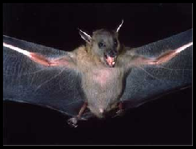




Building a NJ Tree
Cat RatBat Mat
-
0.75 -
1.0 0.8 -
0.6 0.45 0.9
6. Create a new distance matrix using the fusion consensus sequence
Cat
RatBat
Mat
Matt
Fuse the next two closest sequences
8. Repeat until tree completed
16

Slide 28
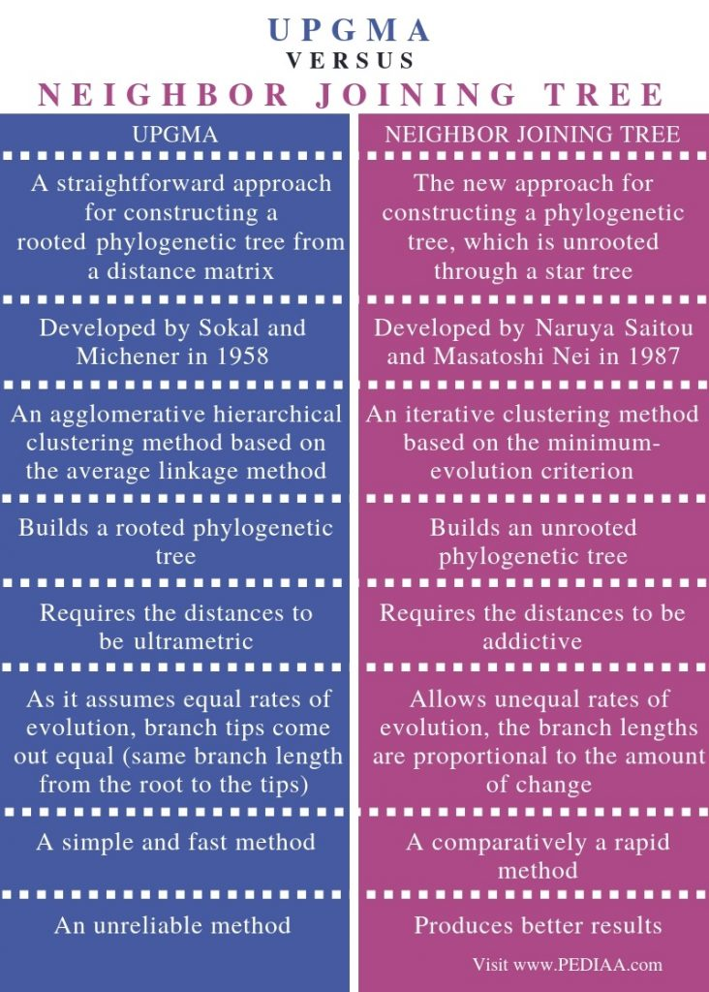
https://pediaa.com/difference-between-upgma-and-neighbor-joining-tree/

Slide 29
Maximum Likelihood (ML) & Bayesian
Much more statistical based
Provides probability of a particular tree (not just the answer)
Similar to Parsimony in that different trees are “scored”, but scores are “likelihoods”
Branch lengths are estimated.
Various models of sequence evolution can be used and tested
Much more computationally challenging
●
●
●
●
●
●

Slide 30
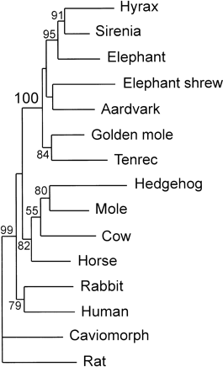
Bootstrapping
The number of times a particular branch is formed in the tree (out of the X times the analysis is done)
High bootstrap values don’t mean that your tree is the true tree!
Bootstrap is a measure of how well your data supports the tree
Bad data, bad alignment, or bad model will still can give high bootstrap values

Slide 31
















Bootstrapping – The Picture Version
1. Slice original MSA of Y residues into Y columns, put the columns into a hat
2. Pull out a random column, place it in column #1 of your new test set
“random sampling”
3. Put the column back in the hat
“with replacement”
4. Pull another column from the hat, place it in column #2 in the test set, put it back
19
5. Repeat until a pseudo-dataset of Y columns has been made

Slide 32
















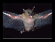
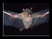
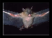









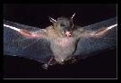



Bootstrapping
●
Repeat N number of times to generate N pseudo-datasets
●
For each pseudo-dataset, draw a tree (yields N trees)
●
Compare your tree to all N trees. How often do the
branching orders in your tree appear in the N pseudo-trees?
3
On branches of your tree, write # of times that branch appeared in your pseudo-dataset trees
2
1
2

Slide 33

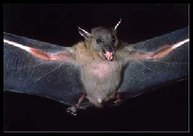
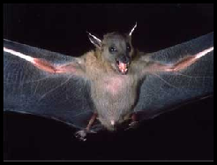







A Completed Tree
●
Alternative displays are possible:
Unrooted
Rooted

Slide 34
General Software
●
A list of everything (>370 programs)
●
http://evolution.genetics.washington.edu/phylip/software.html
●
General Packages
MEGA PHYLIP
http://www.phylogeny.fr
●

Slide 35
Specific Software
●
Parsimony OR Distance Based (e.g. NJ)
●
Clustal, MEGA, PHYLIP, etc
●
ML
●
PhyML, Rax-ML (faster), FastTree (fastest)
●
Bayesian
●
Mr. Bayes, BEAST

Slide 36
Tree Viewing
●
Archaeopteryx
http://www.phylosoft.org/archaeopteryx/
FigTree
http://tree.bio.ed.ac.uk/software/figtree/
Dendroscope
http://ab.inf.uni-tuebingen.de/software/dendroscope/
iTOL
http://itol.embl.de/
●
●
●

Slide 37
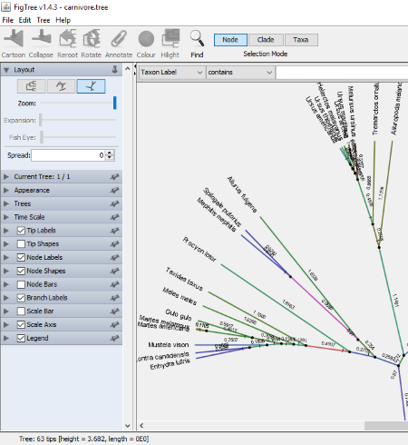
FigTree
https://listoffreeware.com/free-phylogenetic-tree-viewer-software-windows/

Slide 38
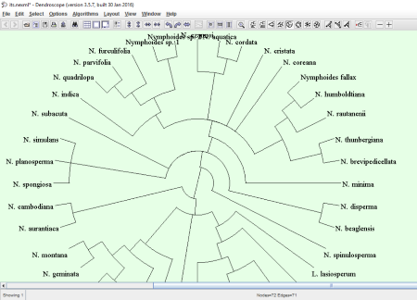
Dendroscope
https://listoffreeware.com/free-phylogenetic-tree-viewer-software-windows/

Slide 39
Tree File Formats
●
Newick
●
Simplest format
●
NEXUS
More complex
Can handle multiple trees and MSAs all in one.
●
●

Slide 40
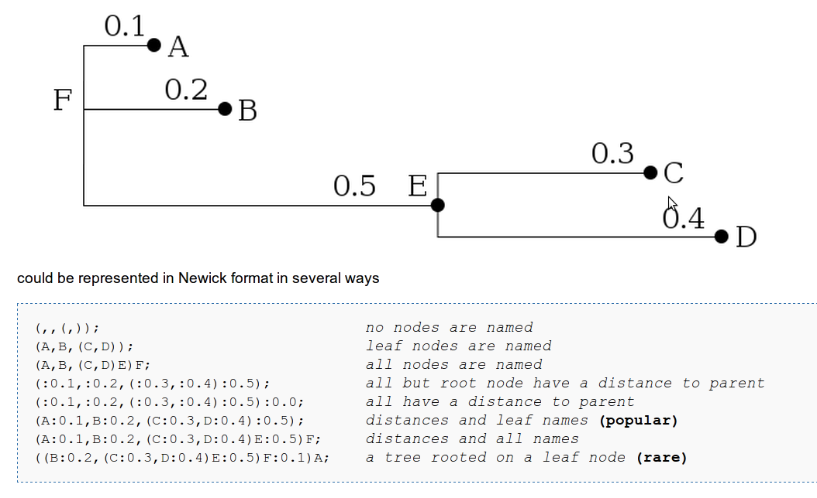
Newick

Slide 41
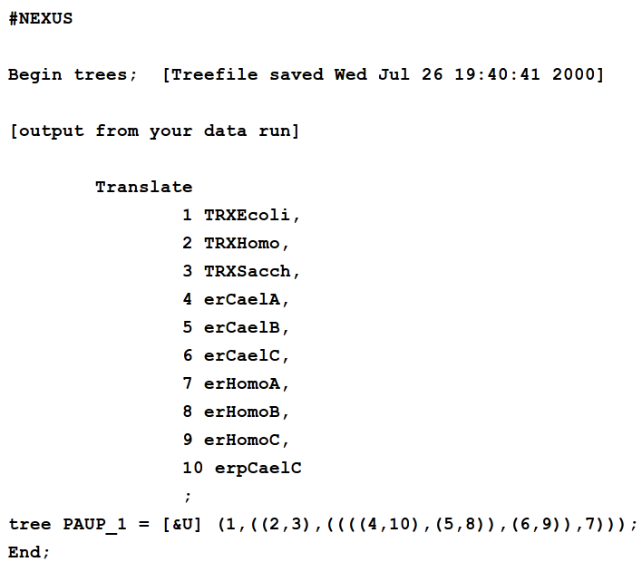
Nexus

Slide 42
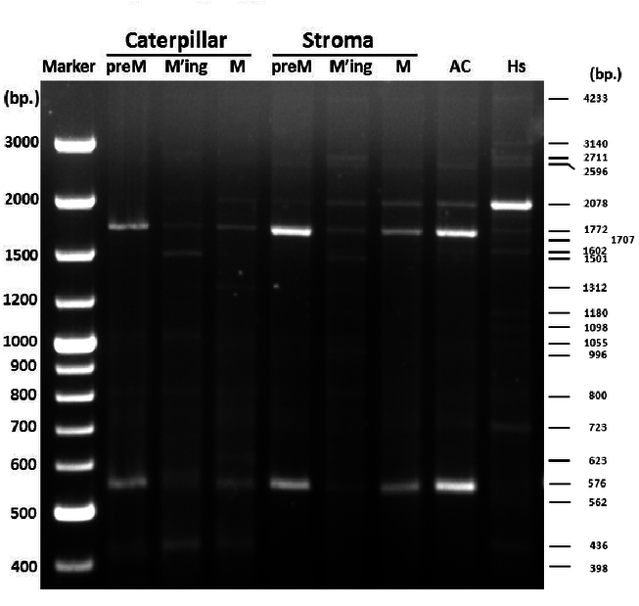
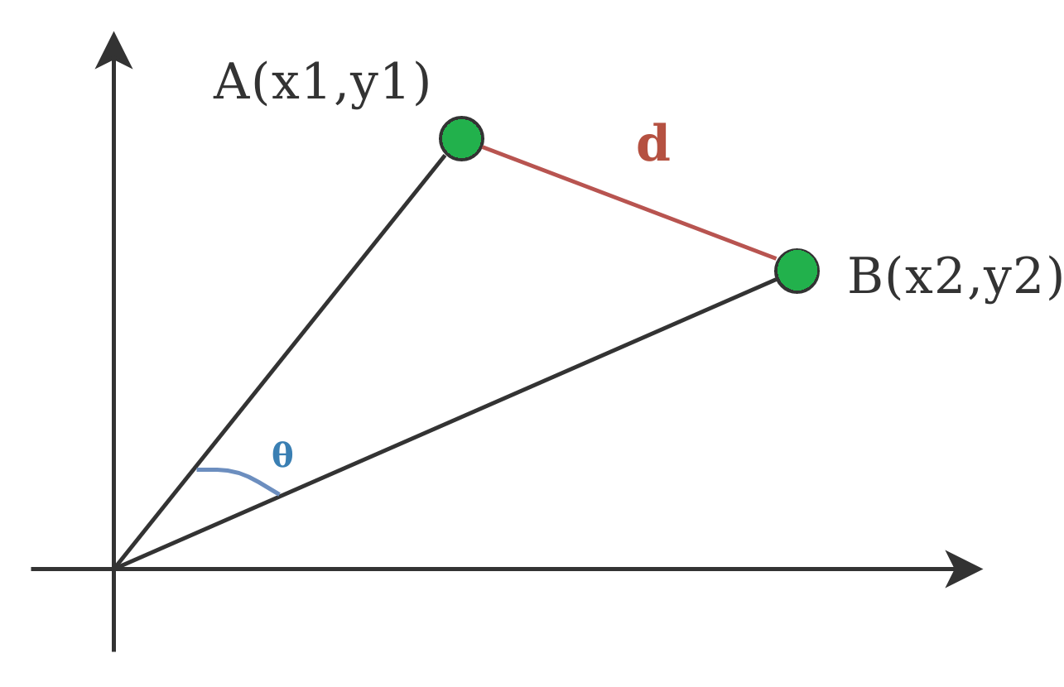
Build phylogenetic tree using NJ method on RAPD data
 | 2078 | 1772 | 576
preMC | 0 | 1 | 1
MingC | 0 | 0 | 0
MC | 0 | 1 | 0
preMS | 0 | 1 | 1
MingS | 0 | 0 | 0
MS | 1 | 1 | 1
AC | 1 | 1 | 1
Hs | 1 | 0 | 0

